Slide 1
Manifold Exploration:
A Markov Chain Monte Carlo Technique for rendering scenes with difficult specular transport
Graduate school of Ocean System Engineering
20163133 YUBIN KIM

Slide 2
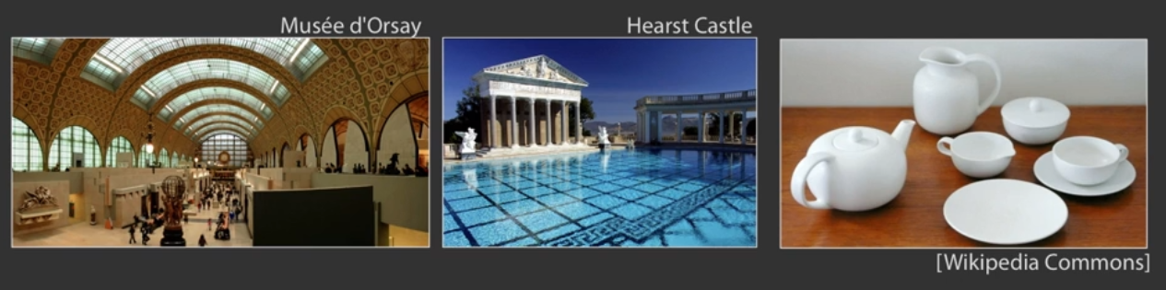
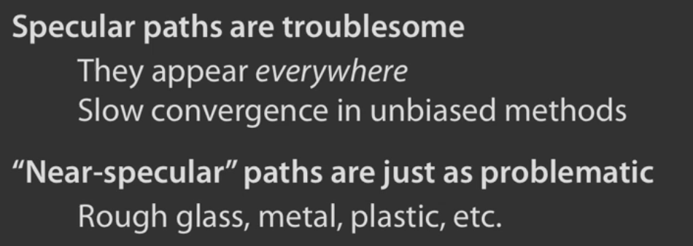
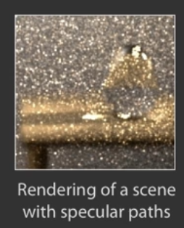
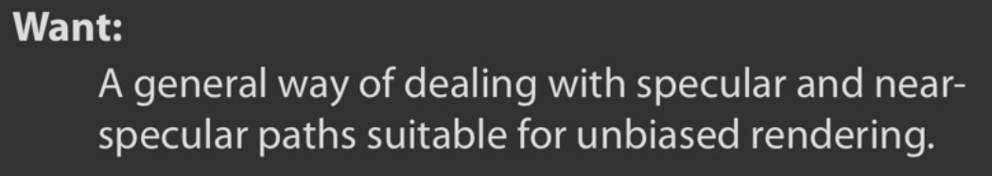
1. Motivation

Slide 3
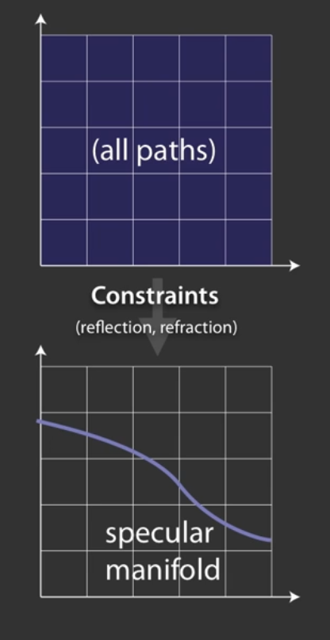
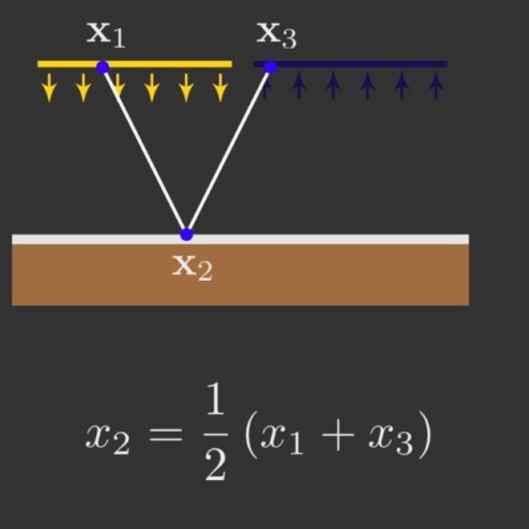
2. Contraint interpretation

Slide 4
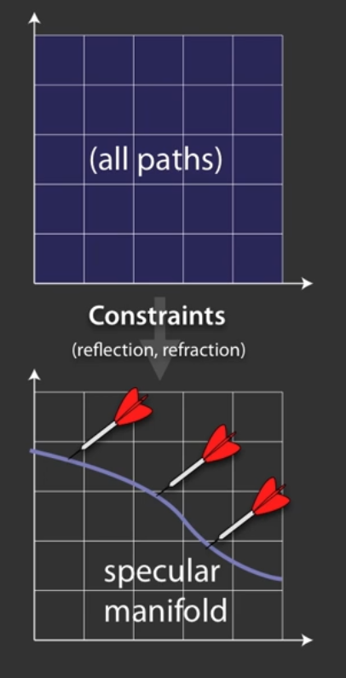
2. Contraint interpretation

Slide 5
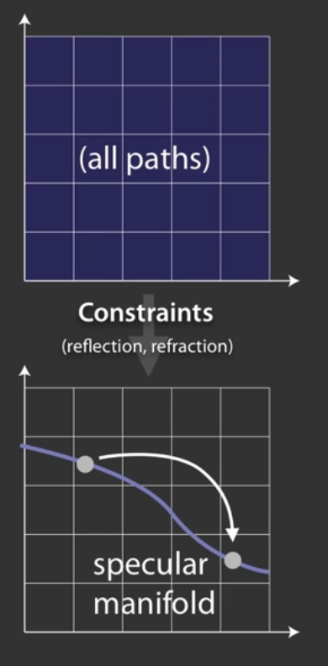
2. Contraint interpretation

Slide 6
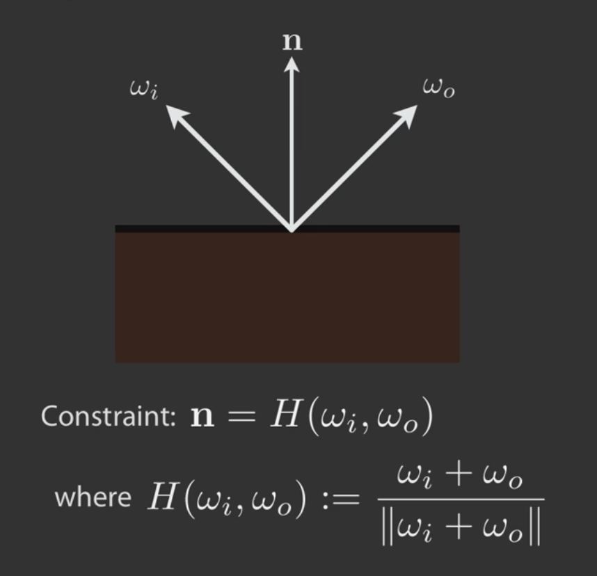
3. Specular path constraint

Slide 7
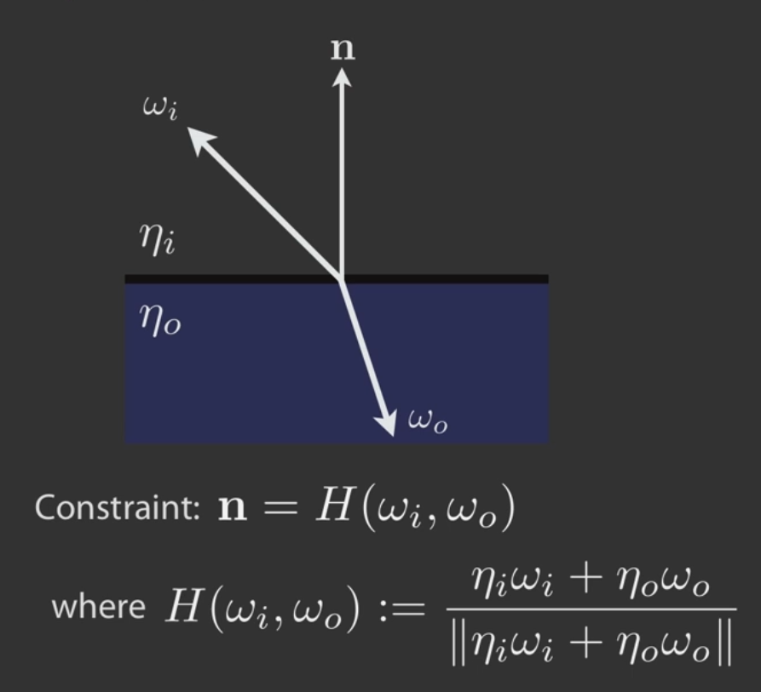
3. Specular path constraint

Slide 8
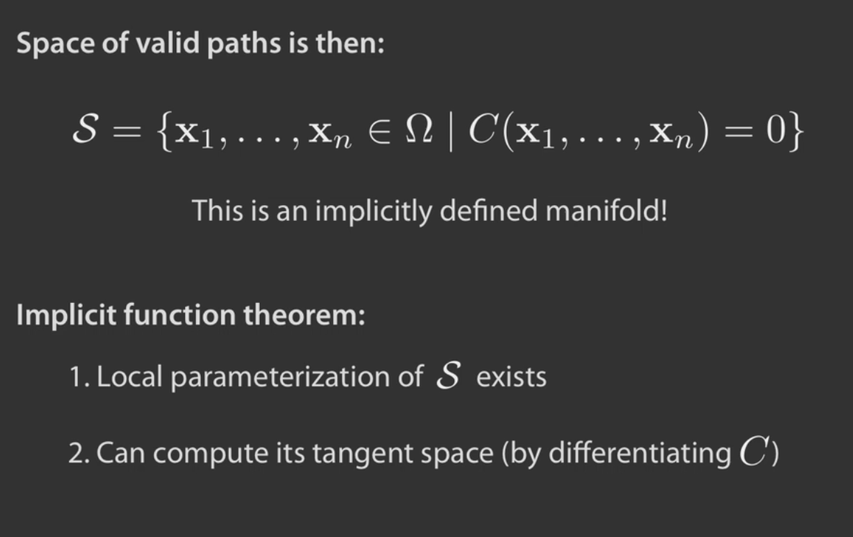
4. Specular manifold

Slide 9
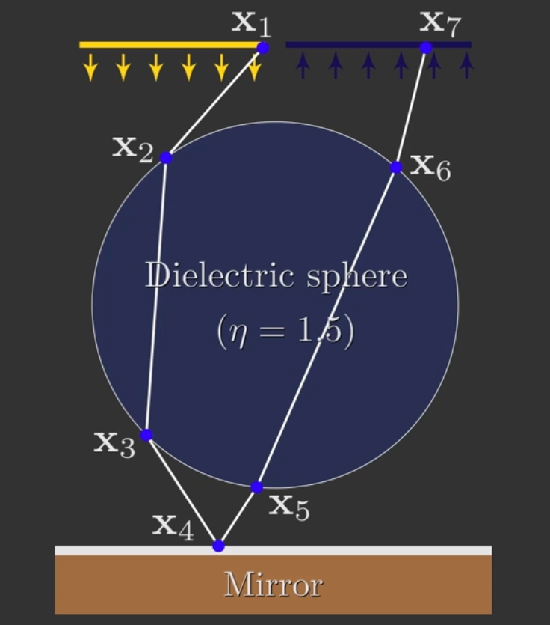
5. Manifold walks

Slide 10
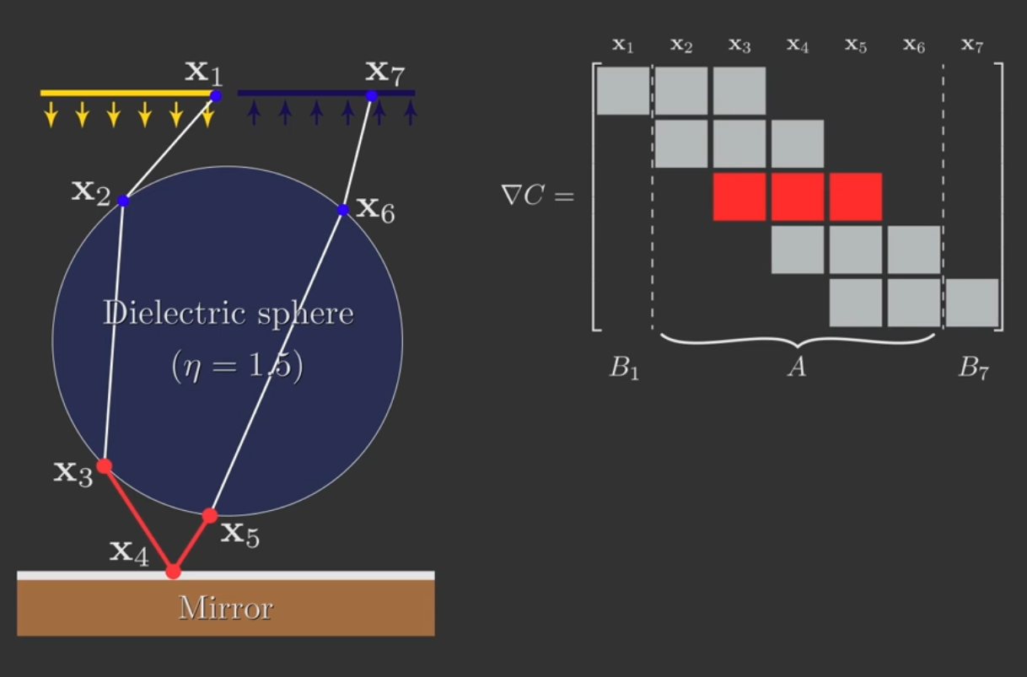
5. Manifold walks

Slide 11
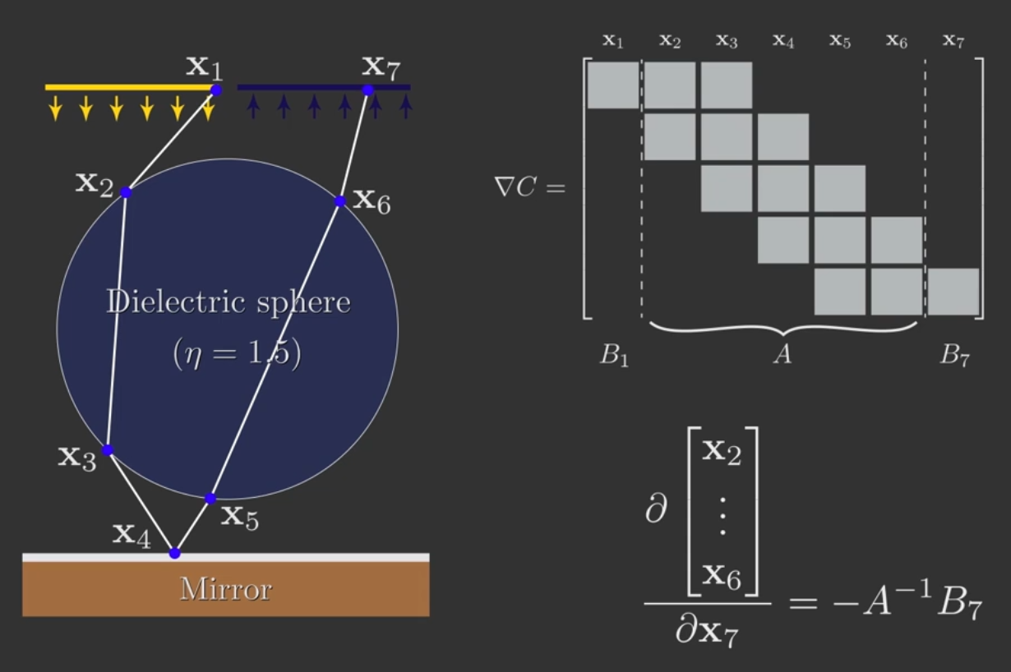
5. Manifold walks

Slide 12
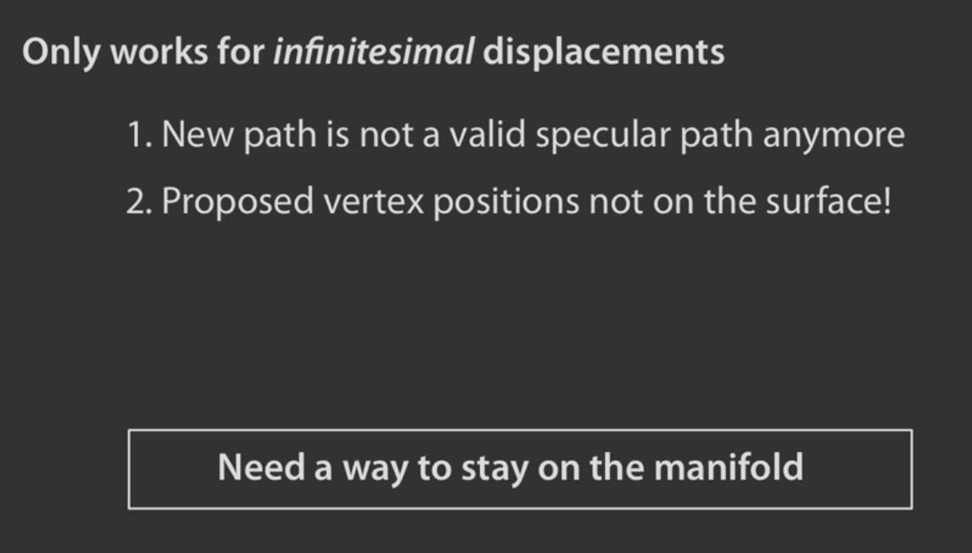
5. Manifold walks

Slide 13
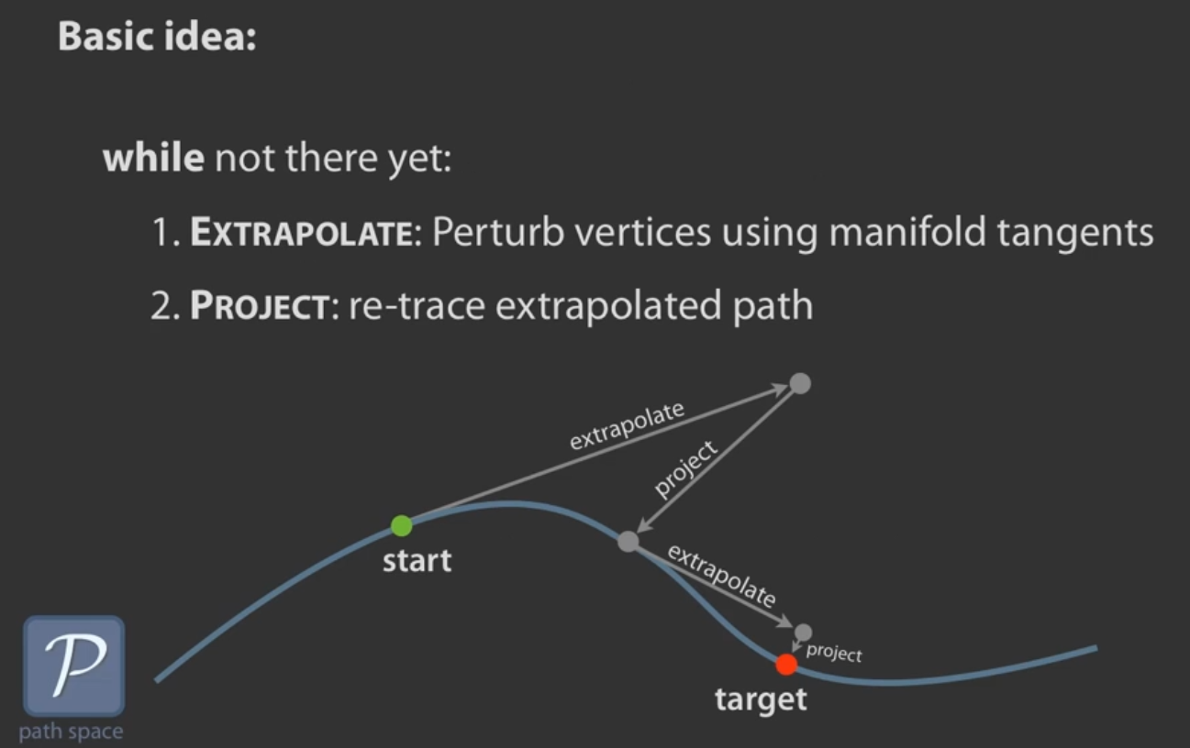
5. Manifold walks

Slide 14
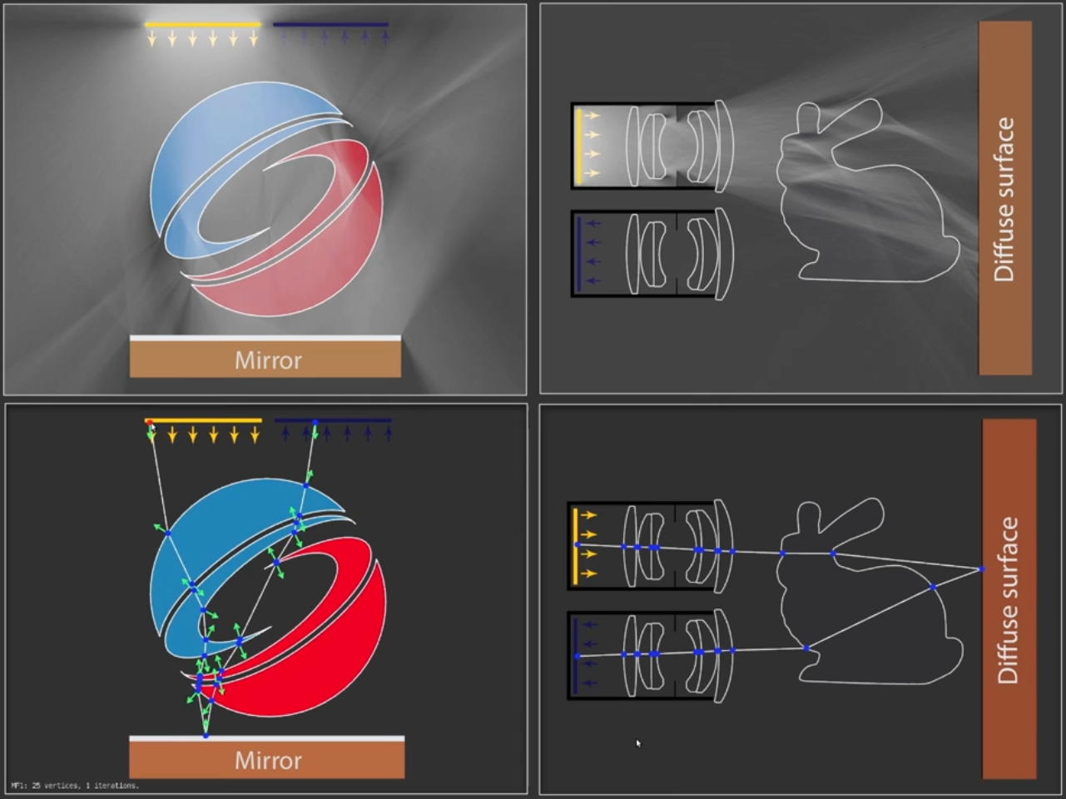
5. Manifold walks

Slide 15
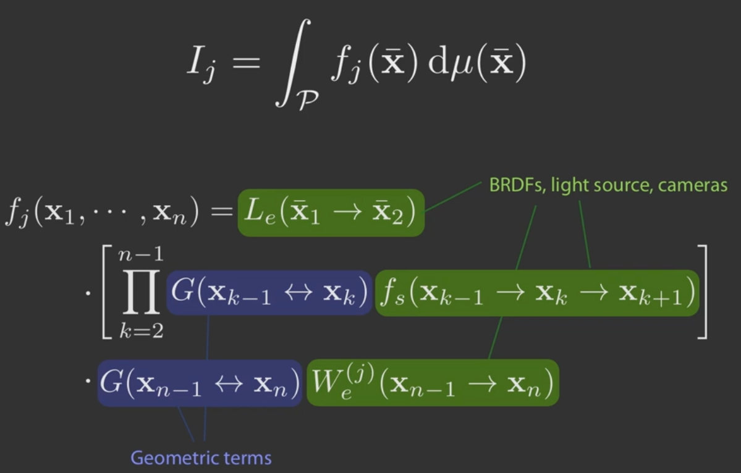
6. Path-space integration

Slide 16
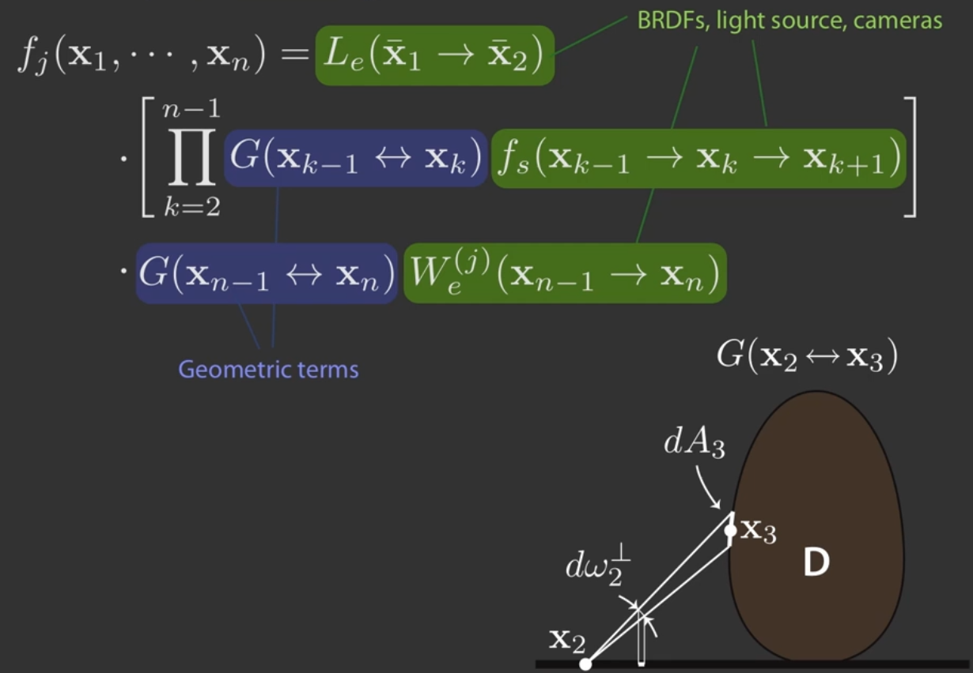
6. Path-space integration

Slide 17
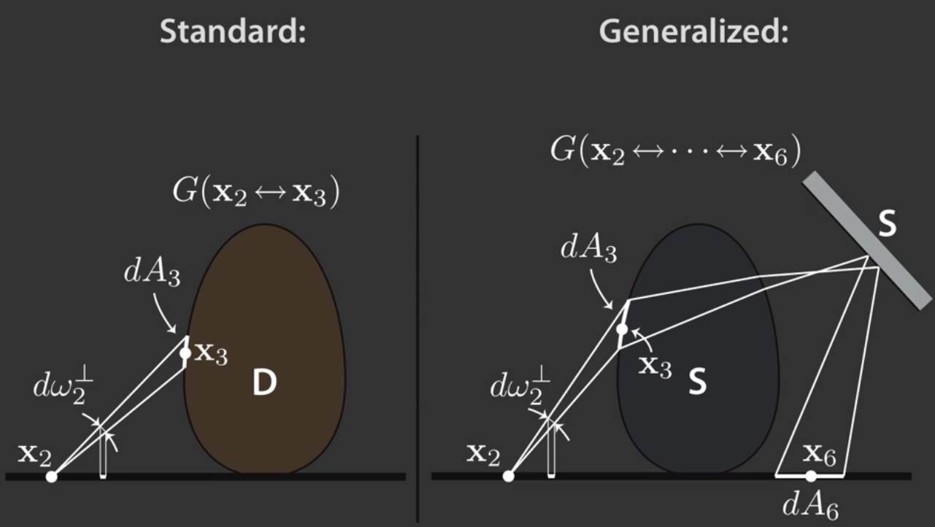
6. Path-space integration

Slide 18
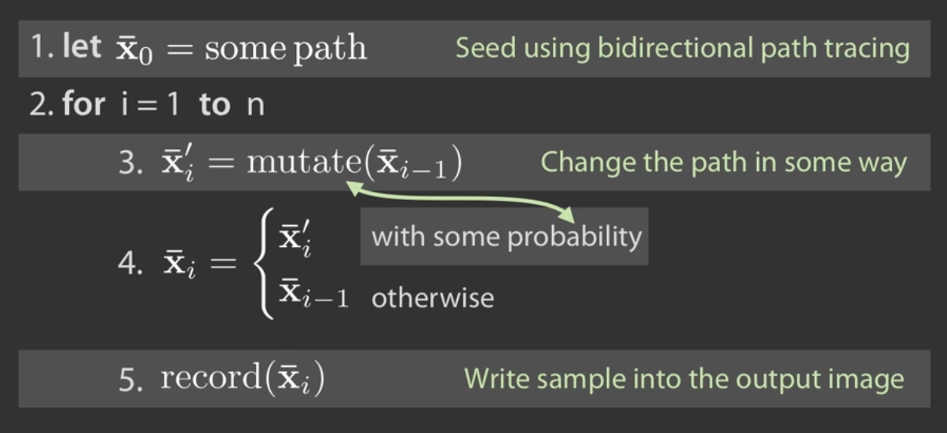
7. MCMC rendering
(Metropolis Hastings algorithm)

Slide 19
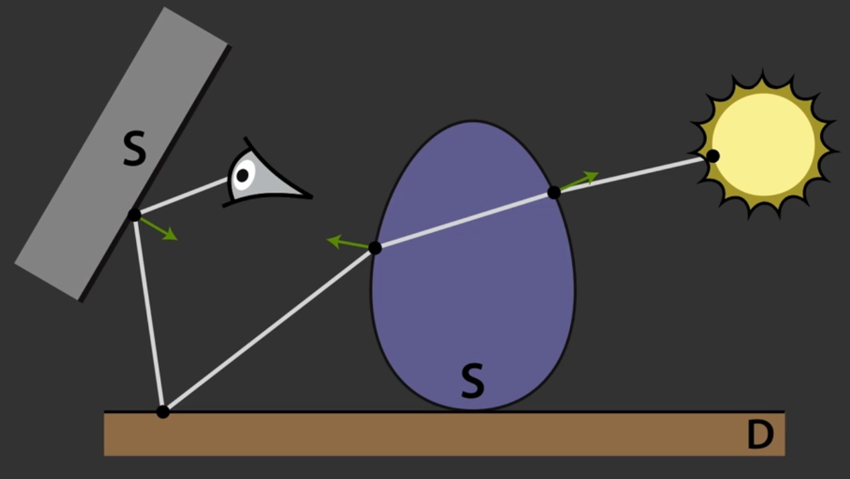
8. Manifold perturbation

Slide 20
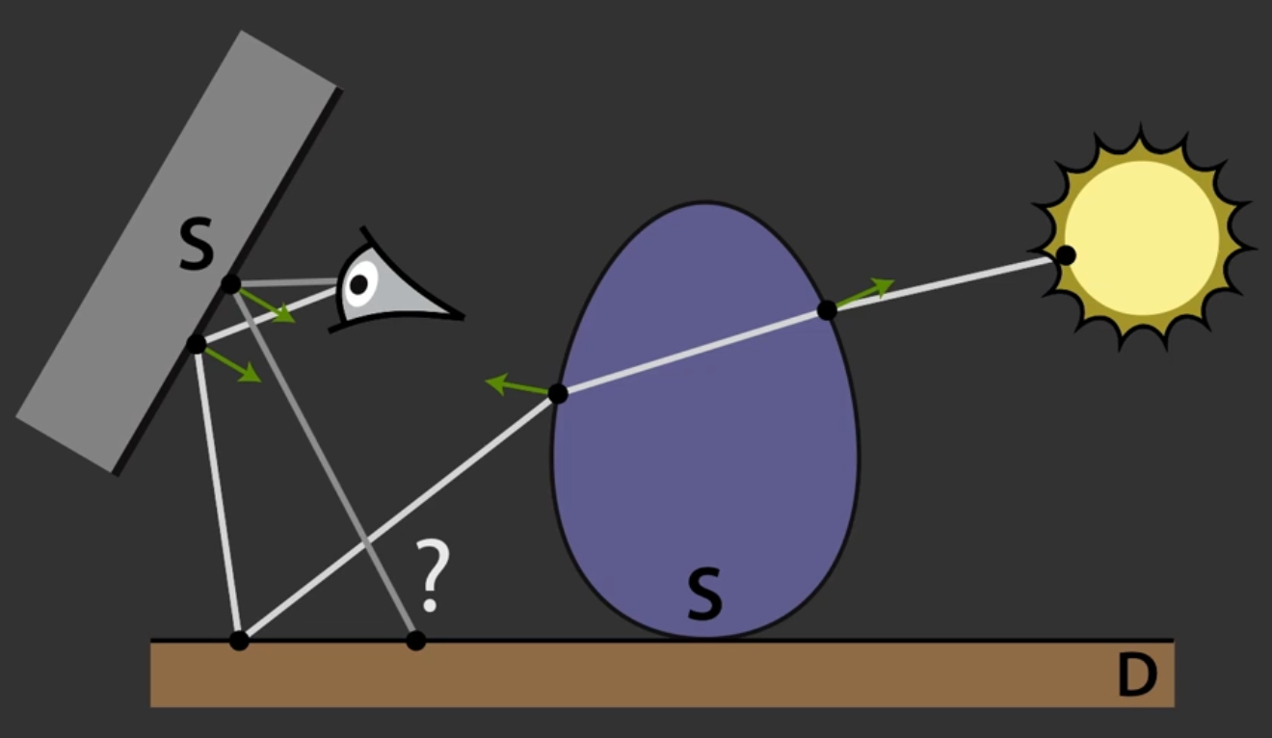
8. Manifold perturbation

Slide 21
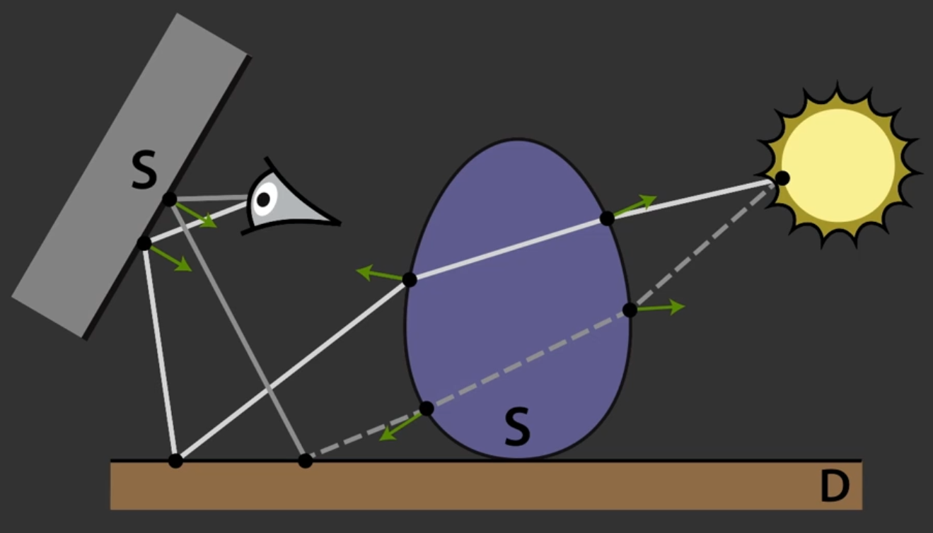
8. Manifold perturbation

Slide 22
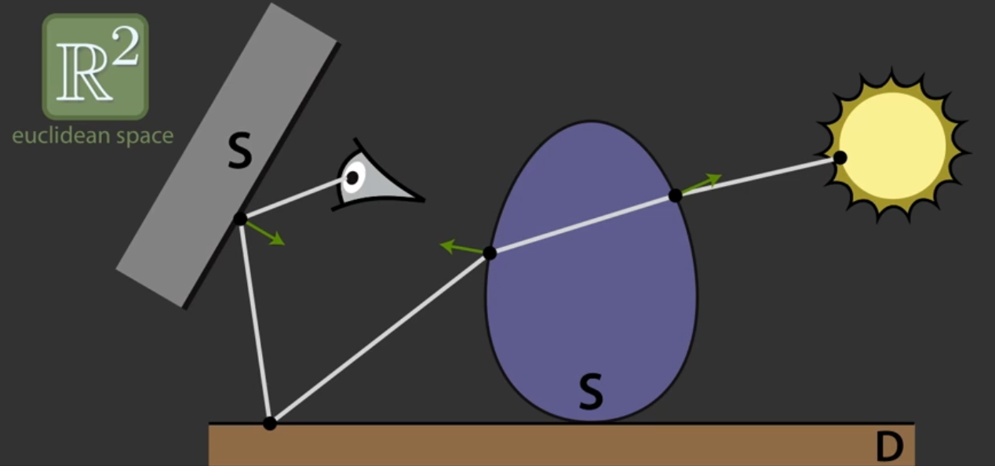
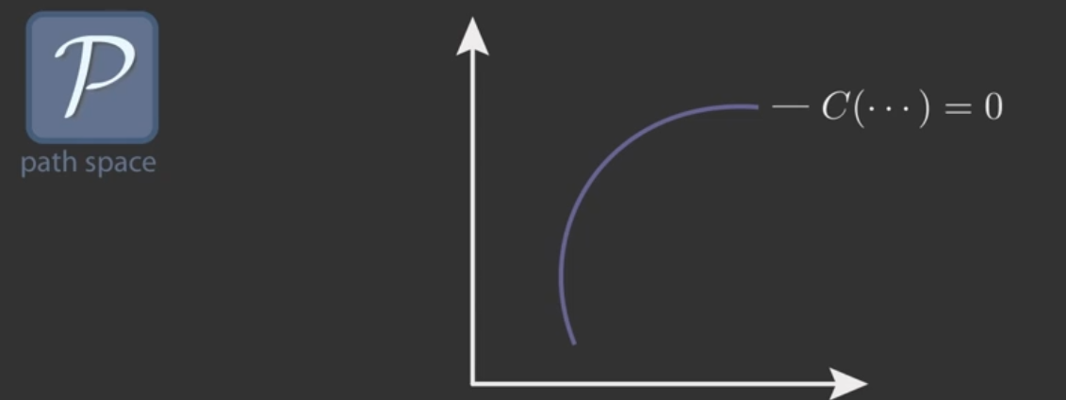
8. Manifold perturbation

Slide 23
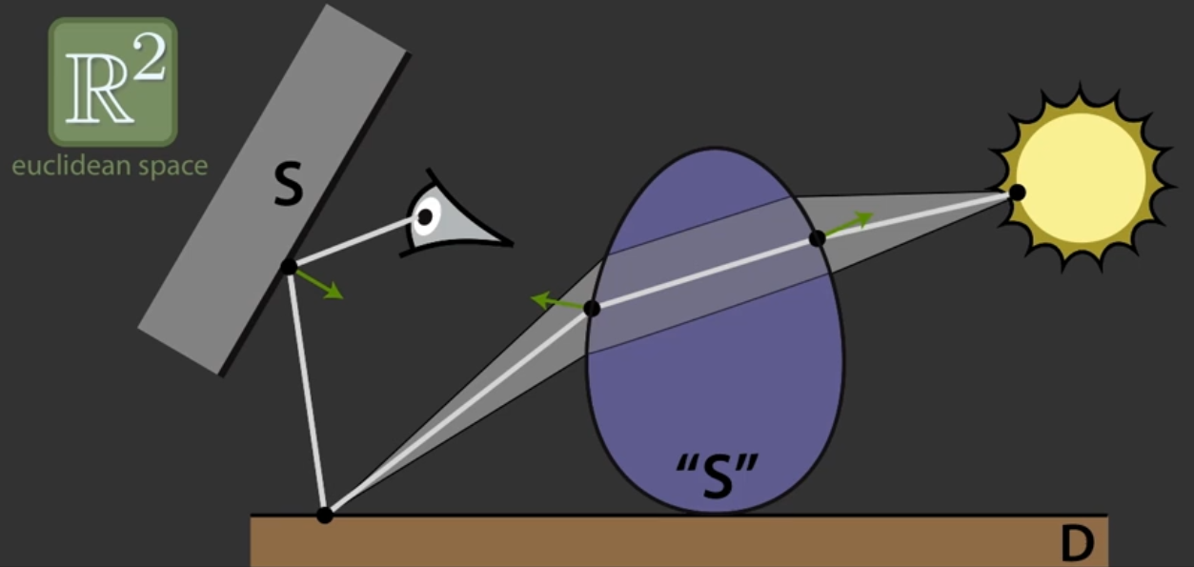
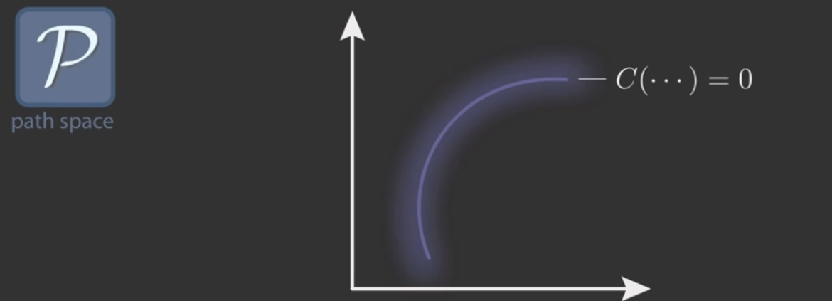
8. Manifold perturbation

Slide 24
Rendering Glints on
High-Resolution Normal-Mapped Specular Surfaces
Graduate school of Ocean System Engineering
20163133 YUBIN KIM

Slide 25
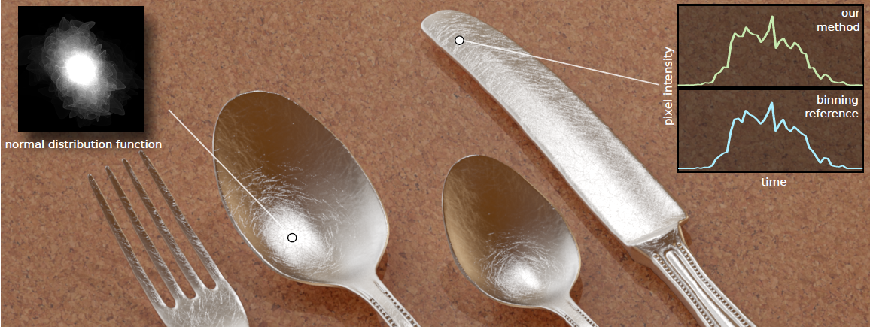
1. Motivation
-Under sharp point lighting, complex specular surfaces can show glinty appearance
but, rendering this is unsolved problem
- In case using Monte Carlo uniform distribution, the energy is concentrated tiny
specular point. So that can cause minus fraction of the pixel

Slide 26
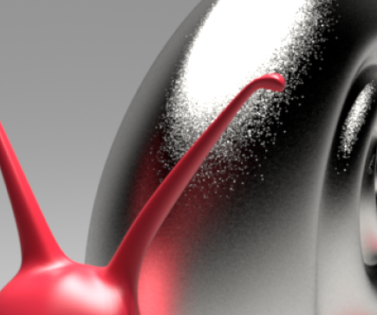
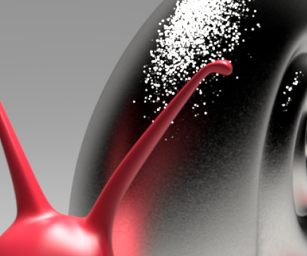
2. Related work
Our method (PNDF)
Naïve pixel samping
(multiple importance uniform pixel sampling)
Multiple importance sampling would not help since the light is a point, and it is the pixel integral that is inefficiently sampled

Slide 27
3. P-NDF
: NDF(normal distribution function) of a surface patch P seen
through a single pixel
Characters
P-NDF can be easily estimated by binning
For direct illumination, we need to evaluate the P-NDF for a single half-vector.
3. P-NDF is different for every pixel, so computations cannot be reused.
In our method, the P-NDF is just a mathematical tool to derive what the correct pixel brightness should be

Slide 28
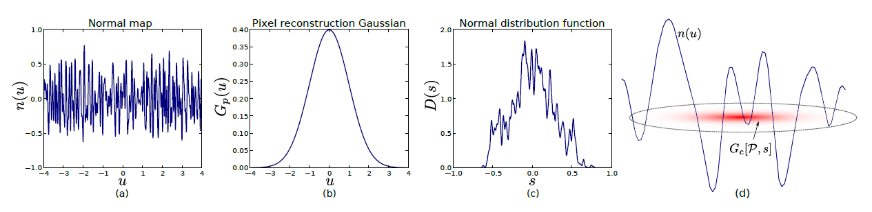
4. P-NDF evaluation in flatland and 3D
u: texture space parameters
n(u): normal map function
Gp(u): pixel Gaussian
s: unit disk parameters
D(s): normal distribution function = P-NDF
Gc[P; s]: combined Gaussian queryfor footprint P and normal s

Slide 29
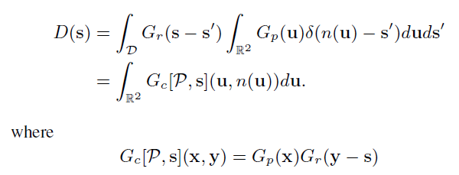
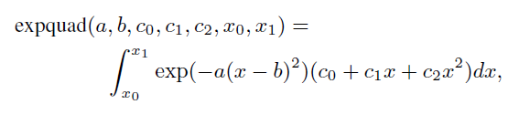
5. Integration Gaussian over a triangle
We choose to approximate the function erf(x) on the interval
[-3; 3] by a piece-wise quadratic function on six subintervals, and
As -1 and 1 for |x| >= 3. The problem thus separates into integrals of the form

Slide 30
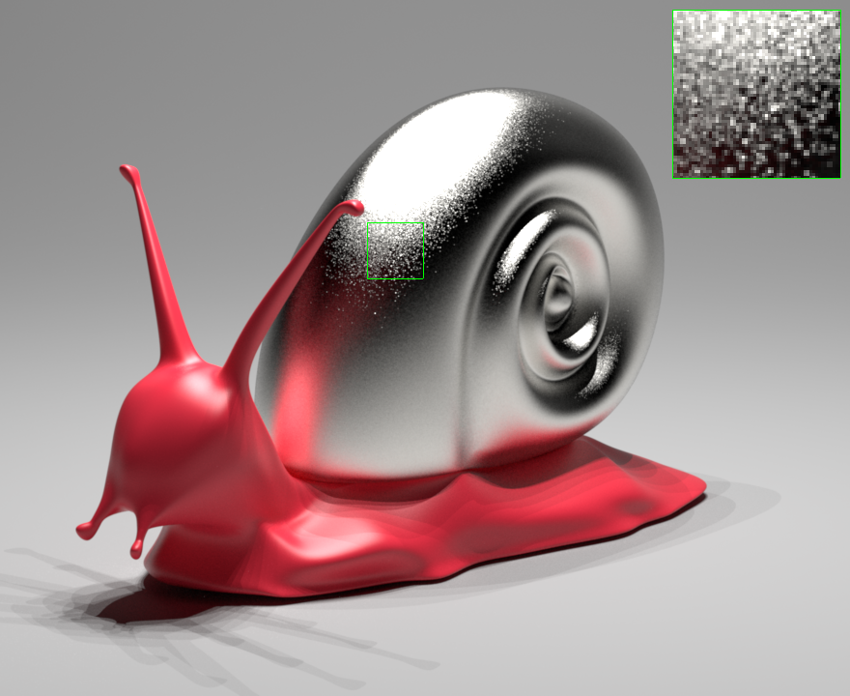
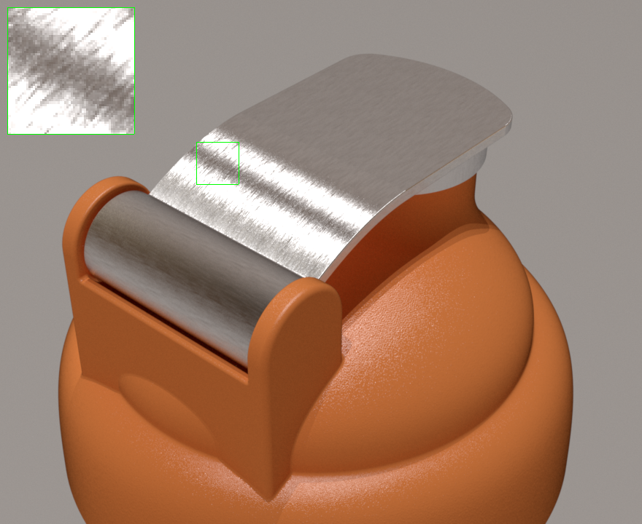
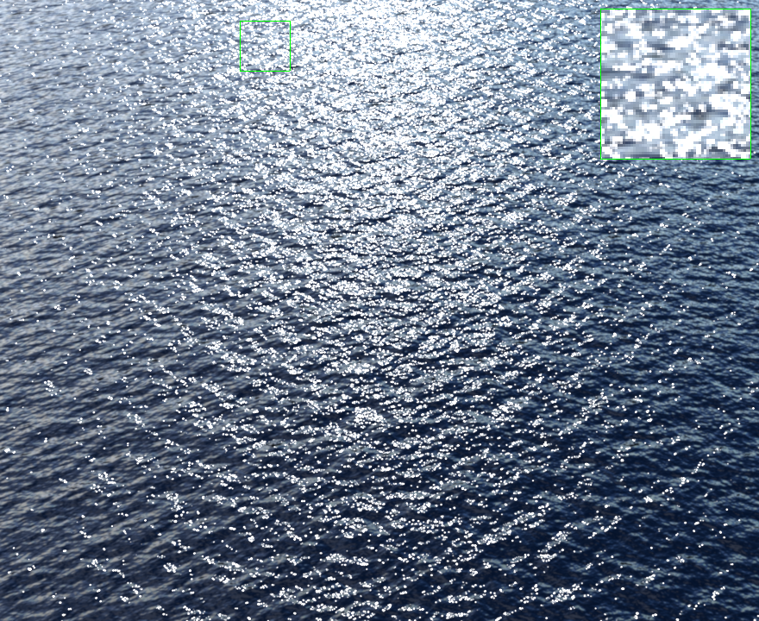
6. Result

Slide 31
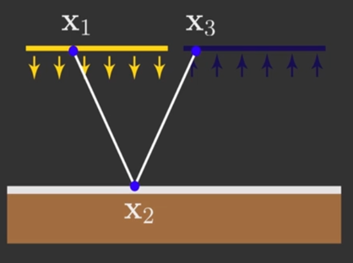
Quiz
How get we get X₂
X1 + X3
X1 * X3
(X1 + X3)/2
X3 – X1
2. What is P in P-NDF
Power
Surface patch
Point
Position

